Slide 1
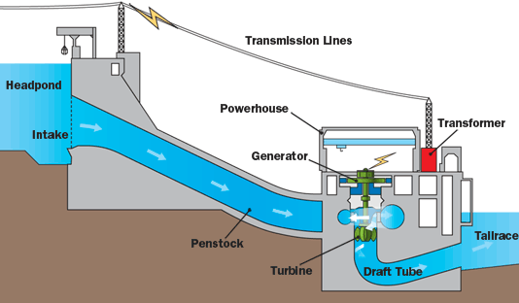
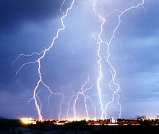
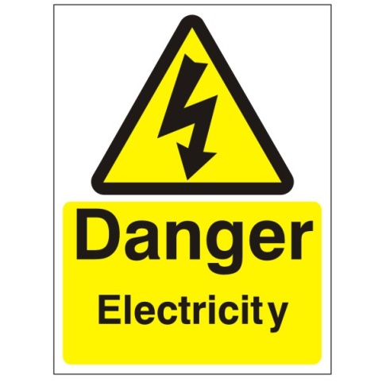
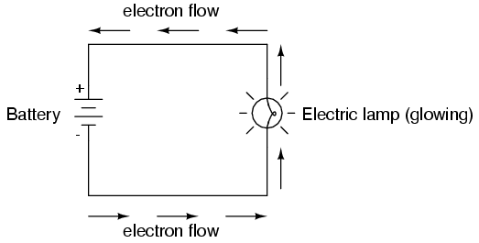
Circuits, Current and Voltage
Series Circuits
Parallel Circuits
Measuring Current
Measuring Voltage
Determining Current and Voltage using circuit diagrams

Slide 2
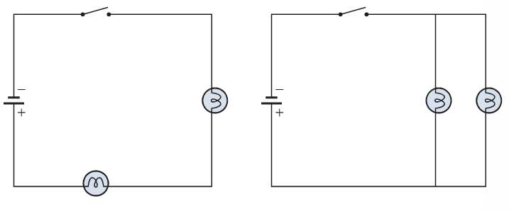
Recall types of circuit
There are two types of electrical circuits
SERIES CIRCUITS
PARALLEL CIRCUITS

Slide 3
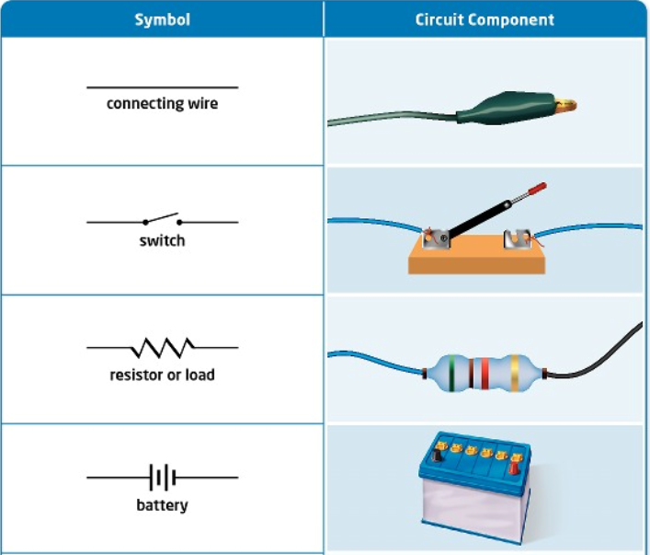
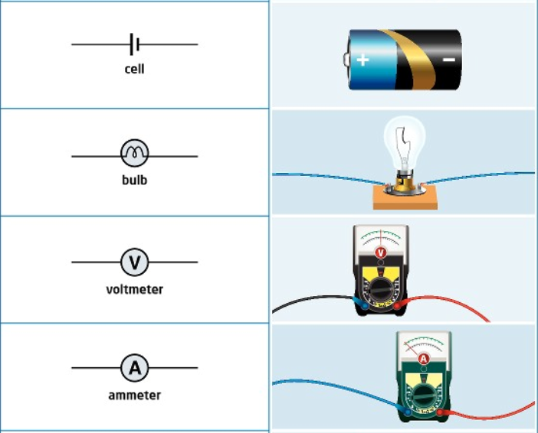
Electric Circuits
Recall Symbols

Slide 4
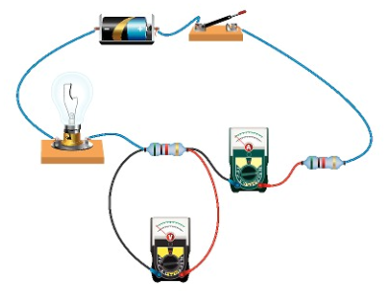
Measuring Current
Electric current is measured in amps (A) using an ammeter connected in series (between the wires) in the circuit.
A

Slide 5
Measuring Current
This is how we draw an ammeter in a circuit.
A
A
SERIES CIRCUIT
PARALLEL CIRCUIT

Slide 6
Recall - Current
The flow of electricity around a circuit is called CURRENT and runs from negative to positive
Current is the amount of electrons passing a given point in one second
I want you to come up with an analogy for Current (some real life example which is similar, e.g. An analogy for the Heart is a pump) …GO!!!!!!!!!!!!!!

Slide 7
Measuring Current
SERIES CIRCUIT
2A
2A
Current is the same at all points in the circuit
2A
The current is the number of electrons passing a given point at any time. Each electron will continue to follow the single path all the way around until it gets back to the cell

Slide 8
Measuring Current in Series

Slide 9
Measuring Current
PARALLEL CIRCUIT
Current is shared between the components.
Current is the number of electrons passing a given point each second. If two electrons come to a divider in the path, one will go one way while the other goes the other. Each path will get an equal share of the electrons.
When the paths come back together, the numbers will combine.
2A
2A
1A
1A

Slide 10
Measuring Current in Parallel

Slide 11
Fill in the missing ammeter readings.
?
?
3A
3A
?
?
?
?
4A
?
?
?
?

Slide 12
Fill in the missing ammeter readings.
?
?
3A
3A
4A
?
1A
?
4A
4A
1A
?
1A

Slide 13
KEY TERM – POTENTIAL DIFFERENCE (VOLTAGE)
How much energy each electron has within the circuit is called POTENTIAL DIFFERENCE (VOLTAGE)
It is called potential energy because it has the potential to do work if something is present to take away the energy
When a charge flows through a flashlight bulb, it enters with a certain amount of energy and exits with less because the light bulb takes some away to light up (similar to paying for something)

Slide 14
Potential Difference Con’t
Since we are calculating the energy lost between one point and another, potential difference can only be calculated over two points (we are finding the difference)

Slide 15
Measuring Voltage
The energy given to each electron is called the voltage. It is measured in volts (V) on a voltmeter
Voltmeters are connected in parallel (around the object)
V

Slide 16
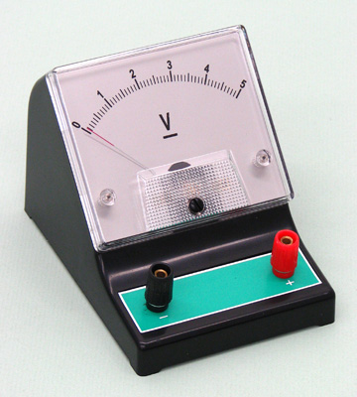
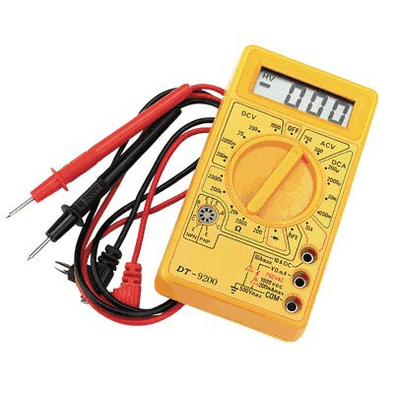
Measuring Voltage
A voltmeter measures the voltage drop in a circuit across two points
Unlike an ammeter a voltmeter is connected across the components
Scientist usually use the term Potential Difference (pd) when they talk about voltage.

Slide 17
Measuring Voltage
This is how we draw a voltmeter in a circuit.
V
V
SERIES CIRCUIT
PARALLEL CIRCUIT

Slide 18
Measuring Voltage
V
V
V
V

Slide 19
Sports Analogy
How much a sports venue makes at a sporting event depends on two things
How many people come
All the people who enter every second = Current
2) How much each ticket costs
- What the person needs to give up to enter = Voltage

Slide 20
Series Circuit
Voltage is shared between the components
Each electron is given a certain amount of energy to start (its voltage), if it gives half it’s energy to the first bulb, it will only have half left to give to the second bulb.
3V
1.5V
1.5V

Slide 21
Measuring Voltage in Series

Slide 22
Parallel Circuit
Voltage is the same in all parts of a parallel circuit.
Each electron is given a certain amount of energy by the battery, the amount of energy they can give doesn’t depend on their route (each electron can give 3V)
3V
3V
3V

Slide 23
Measuring Current in Parallel

Slide 24
Measuring Current & Voltage
Look at the next few slides
Think about the missing current and voltage readings.
- Do not go ahead as the answers will pop up
Remember the rules for current and voltage in series and parallel circuits.

Slide 25
Measuring Current & Voltage
a)
6V
4A
A
V
V
A
Determine the missing current and voltage readings.

Slide 26
Measuring Current & Voltage
Determine the missing current and voltage readings.
b)
6V
4A
A
V
A
V
A

Slide 27
Answers
a)
b)
6V
6V
4A
4A
6V
4A
4A
3V
3V
2A
4A
6V
2A

Slide 28
More diagrams found on a circuit diagram
Motor
Fuse
M

Slide 29
Circuits Review
A circuit is a continuous loop where electricity can flow
A circuit is made up of:
An energy sources (battery, etc.)
Connecting wires – usually copper
An electrical device called a load (e.g. a toaster or light)
A switch such as a light switch in your home
** All these things need to be in place for the circuit to function **

Slide 30
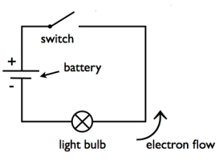
Open Switch
This diagram represents an open switch
Switches are anything that turn something on – e.g. light switch
If the switch is open then electrons can’t flow past and light will be off
- If the switch is closed then electrons can flow past and light will be on (turning on a light switch)

Slide 31
Series and Parallel Circuits
Circuit Type | Number of paths for electric current to follow | Voltage (Electrical Energy) Shared/Not Shared | Current Shared /Not Shared
Series | _________ | _________ | _________
Parallel | _________ | _________ | _________
You need to know how to explain and give reasons for the above facts in your own words

Slide 32
Series and Parallel Circuits
Circuit Type | Number of paths for electric current to follow | Voltage (Electrical Energy) Shared/Not Shared | Current Shared /Not Shared
Series | One Path | Shared | Not Shared
Parallel | More than one path | Not Shared | Shared
You needs to know how to explain and give reasons for the above facts in your own words

